Slide 1

BLOCKCHAIN TECHNOLOGY

Slide 2
Prepared by:
AMRITMANI ARYAL
ABHISHEK SUBEDI
ROSHAN KANDEL
UJWAL THAPA

Slide 3

Topics to be discussed:
General Information about Blockchain technology.
How it works?
Needs and Applications.
How blockchain will change our world/conclusion.

Slide 4
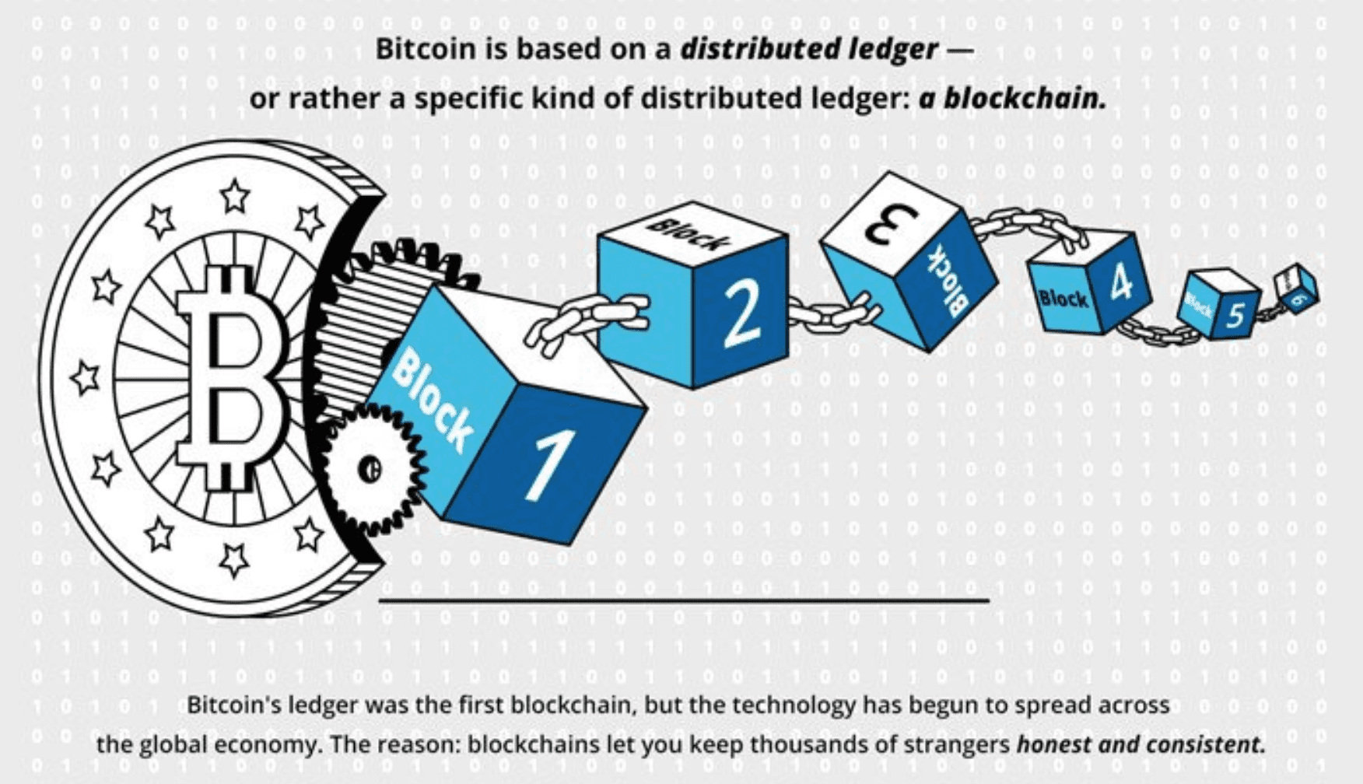
WHAT IS BLOCKCHAIN??
A blockchain is an open distributed digital ledger that can record transactions between two parties efficiently and in a verifiable and in a permanent way.
Open
Distributed
P2P
Permanent

Slide 5
Blockchain was invented by a person going by the name of Satoshi Nakomoto in 2008.
It was originally invented to serve as the public transaction ledger of the cryptocurrency bitcoin.
The real identity of Satoshi Nakomoto is unknown up until now.
The use of blockchain is not limited to just bitcoin as it is now being used or implemented in many different fields. Among those are:
Cryptocurrencies
Smart Contracts
Financial services
Video games etc.

Slide 6
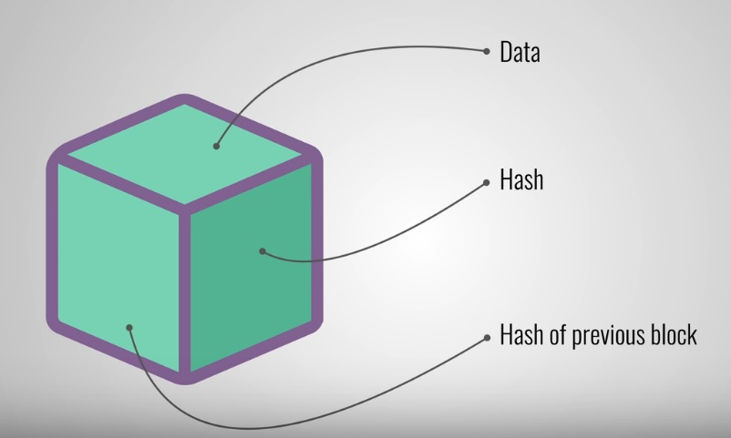
How does a blockchain work?
Blockchain ➔ a chain of blocks.
Each block has primarily 3 attributes.
Data
Hash
Hash of previous block

Slide 7
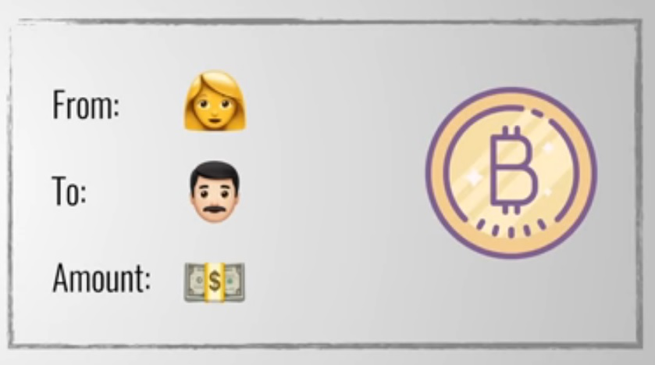
Data
Depends on the implementation of blockchain.
For example a cryptocurrency might have
data fields that hold transaction details like
sender, receiver and transaction amount.

Slide 8
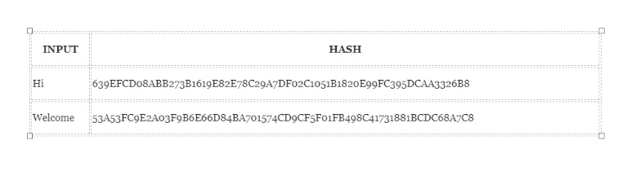
Hash
Hash is a binary string of fixed length.
Unique hash value(digest) is generated by feeding data to a cryptographic hash function.
Example: Secure Hashing Algorithm 256 (SHA-256)

Slide 9
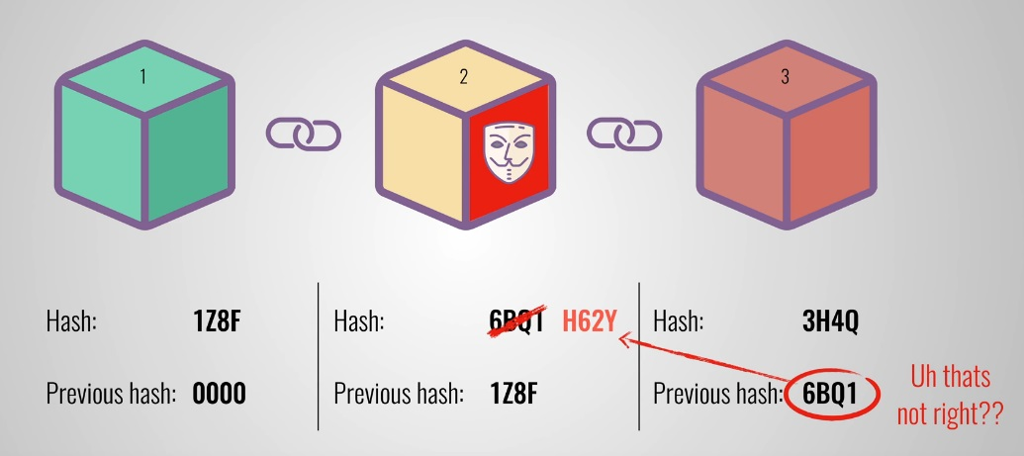
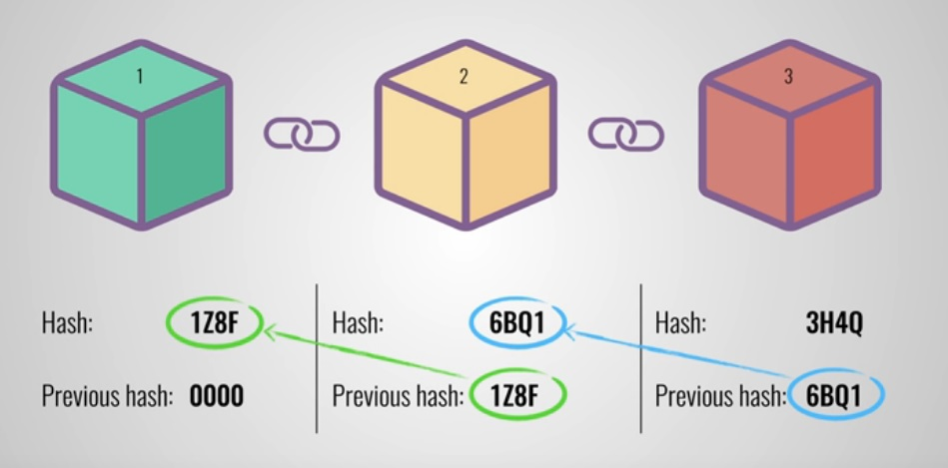
How are blocks “chained”?
Each block contains hash of previous block.
The hash of previous block along with the data of current block is used to generate hash of current block.

Slide 10
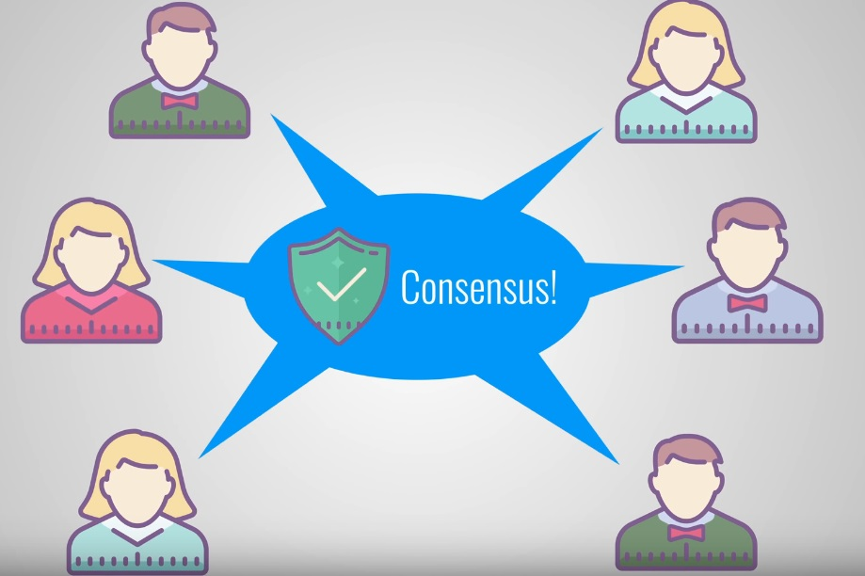
Is it secure?
Security of a blockchain comes from
Hashing
Proof of work
Distributed and open
peer-to-peer network

Slide 11
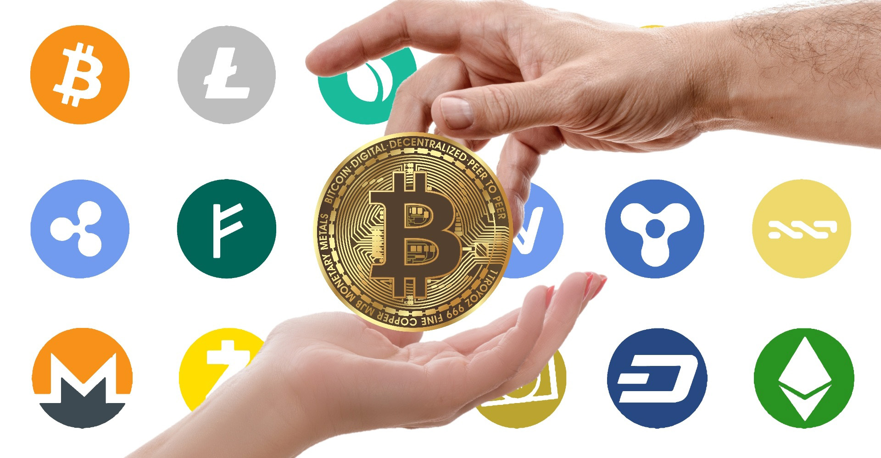
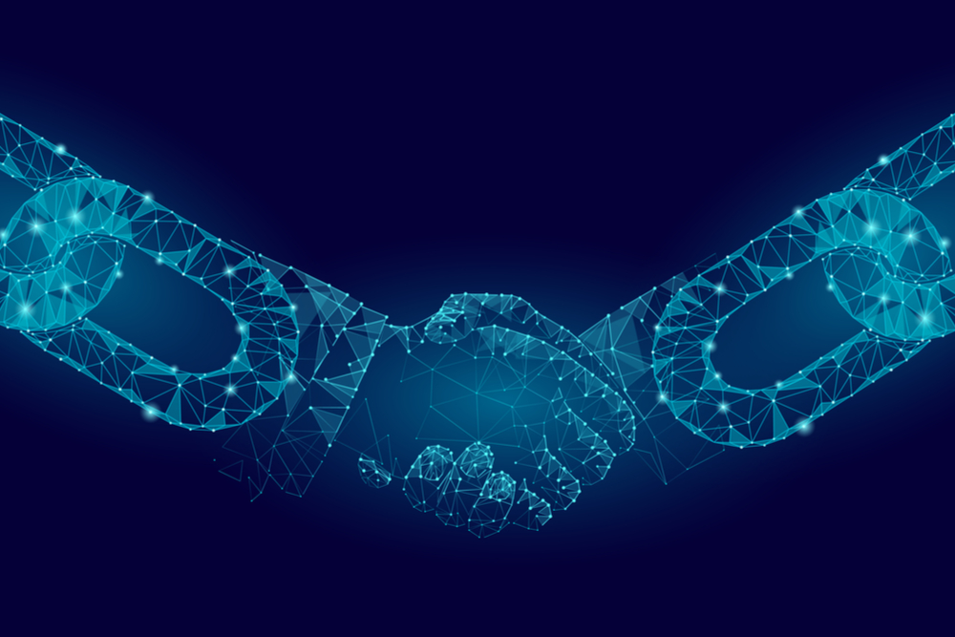
Needs and Applications
Blockchain technology can be integrated into multiple areas.
It is believed that this technology has been hyped with unrealistic claims.
To mitigate risk, businesses are reluctant to place block chain at the core of the business structure.

Slide 12
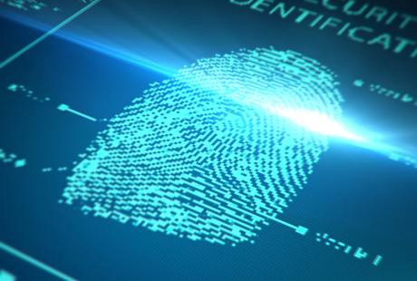
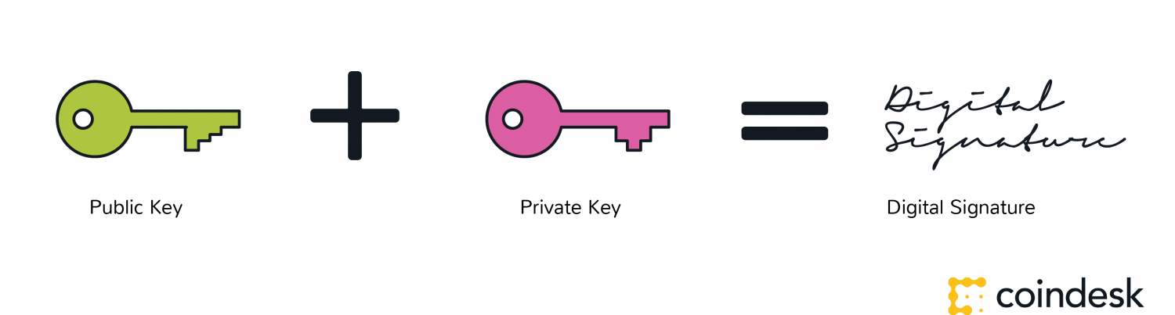
Digital Identity
Cryptographic keys in the hands of individuals allow for new ownership rights and a basis to form interesting digital relationships.
Because it is not based on accounts and permissions associated with accounts, because it is a push transaction, and because ownership of private keys is ownership of the digital asset, this places a new and secure way to manage identity in the digital world that avoids exposing users to sharing too much vulnerable personal information.

Slide 13
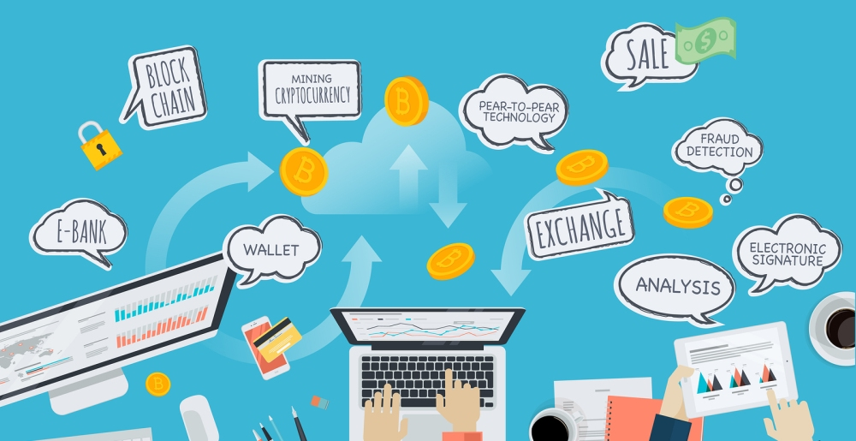
Tokenization
For the purposes of authenticating a unique physical item, the items are paired with a corresponding digital token.
This essentially means tokens are used as to bind the physical and digital worlds.
These digital tokens are useful for supply chain management, intellectual property, and anti-counterfeiting and fraud detection.

Slide 14
For automated governance
Bitcoin itself is an example of automated governance, or a DAO (decentralized autonomous organization). It, and other projects, remain experiments in governance, and much research is missing on this subject.
For markets
Another way to think of Cryptocurrency is as a digital bearer bond.
This simply means establishing a digitally unique identity for keys to control code that can express particular ownership rights (e.g. it can be owned or can own other things).
These tokens mean that ownership of code can come to represent a stock, a physical item or any other asset.

Slide 15

For streamlining of clearing and settlement
In the world of stock trading, there is a term ‘T+3’. This means, a trade (T) is followed by three days before the trade is accepted (settled).
There are non-blockchain ways to get this number down, but not without compromising security and risk.
With blockchain technology, however, trade is settlement, and we have a T+0 equation.

Slide 16
Smart Contracts
Blockchains are where digital relationships are being formed and secured.
Block chain based smart contracts are proposed contracts that could be partially or fully executed or enforced without human interaction.
This version of smart contracts seeks to use information and documents stored in blockchains to support complex legal agreements.
One of the main objectives of a smart contract is automated escrow.
“No viable smart contract systems have yet emerged.”

Slide 17
Blockchain with video games
The first blockchain based game, Hunter Coin, was released in February, 2014.
Another blockchain game is Crypto Kitties, launched in November 2017.
The Blockchain Game Alliance was formed in September 2018 to explore alternative uses of blockchains in video gaming

Slide 18
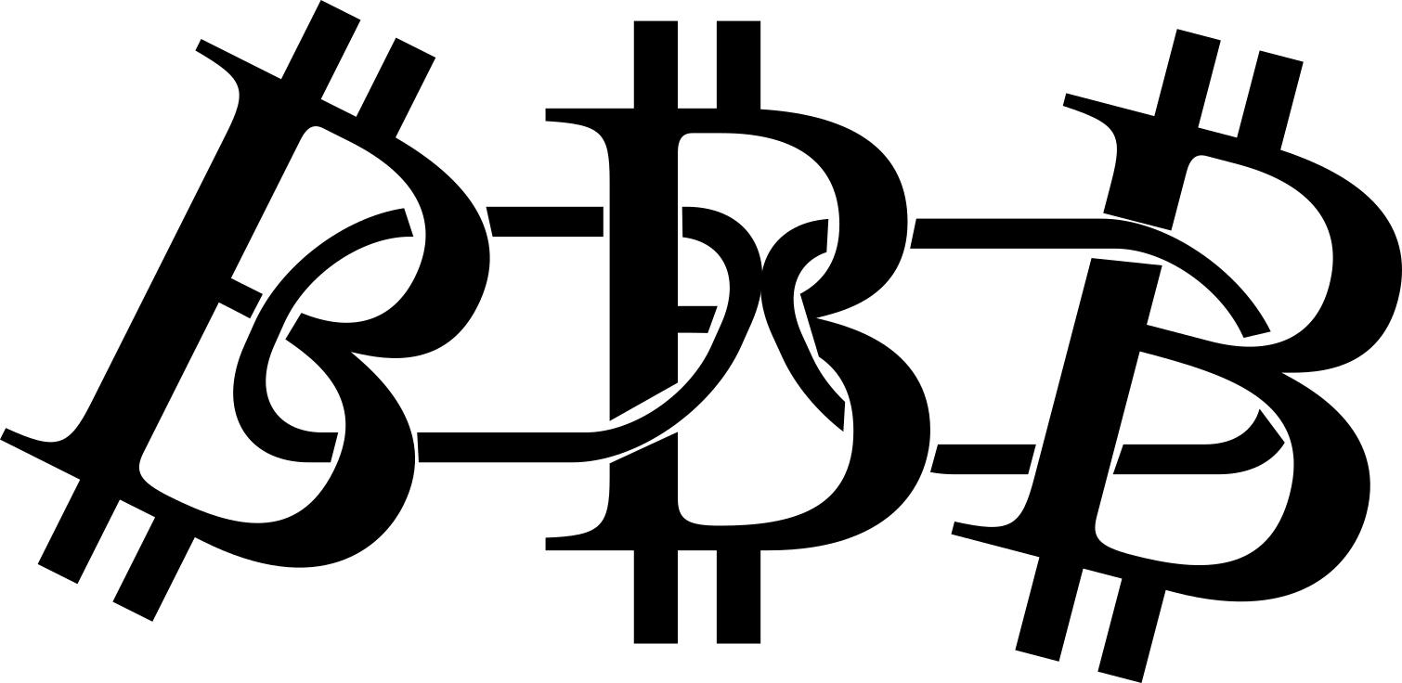
Supply Chain
Cryptocurrency
A crypto currency is a digital asset designed to work as a medium of exchange that uses strong cryptography to secure financial transactions, control the creation of additional units, and verify the transfer of assets.
Bitcoin, first released as open-source software in 2009, is generally considered the first decentralized crypto currency.
There are a number of efforts and industry organizations working to employ block chains in supply chain logistics and supply chain management.
The Blockchain in Transport Alliance (BiTA) works to develop open standards for supply chains.

Slide 19


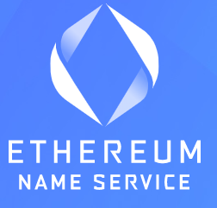


Use case/Implementation of Blockchain(Current Scenarios)
Banking and Payment System(Digital wallet and Cryptocurrency) Abra – allow invest in 30 cryptocurrencies and 50 fiat currencies Edge - allow many assets to buy, store and trade securely blockchain and Coinbase wallet, Bitcoin, Ethereum, Litecoin
Cyber Security and Communication Block Armour – secure enterprise system and Iot communication Hacken – Token platform designed to secure blockchain protocol, reduce attack
Database and DNS Ethereum Name Service(ENS) – replace long address with human readable names FlureeDB – decentralized database sol for enhanced security and interoperability Storj – decentralized cloud storage (encrypt-split-distribute)

Slide 20




Smart Transportation Arcade city and Lazooz – blockchain base system for real time ride sharing Car eWallet – innovative payment for electric car charging while on the go
Voting and Digital Identity Followmyvote – world’s first secure open-source online voting software Civic – create secure digital identity Democracy Earth – enables token-based community participation.
Entertainment Industry AudioCoin – digital currency for music industry DTube – decentralized video network, Viewly Alpha - experimental video platform
Apart from these, Dot-Bit-enabled websites(.bit) , Crowdfunding for charity , raise money from different source.*Dubai is aiming to put all its government documents on the blockchain by 2020.
https://arcade.city/

Slide 21
How Blockchain Will change our world ?
Blockchain has the huge Potential to make global change.
Could impact as much as Internet has in Present World.
Might replace the Fiat Currency
Because of Blockchain, the future generation technology will have:
Decentralized and distributed system which is easier to use and verify.
More advanced Cryptography/Hashing Algorithm and digital signature for security purposes.

Slide 22
Conclusion
Blockchain can be used in every aspect of our daily life as it make the work done in simpler, trustful, reliable, immutable, secure, transparent, beneficial by using power of decentralized self-governed peer to peer cryptography base system.

Slide 23
Q&A Session

Slide 24
